Slide 1
VGGT: Visual Geometry Grounded Transformer
Jianyuan Wang^{1,2} Minghao Chen^{1,2} Nikita Karaev^{1,2} Andrea Vedaldi^{1,2}
Christian Rupprecht¹ David Novotny²
¹Visual Geometry Group, University of Oxford ²Meta AI

Slide 2
Goal
Given a set of images, utilize a feedforward neural network to estimate the 3D attributes of a scene.
Attributes: camera parameters g_{i} ∈ R⁹ (intrinsics and extrinsics), its depth map D_{i} ∈ R^{H×W}, its point map P_{i} ∈ R^{3×H×W}, and 3D point track grids T_{i} ∈ R^{C×H×W}.

Slide 3
Background
3D reconstruction has been approached with visual-geometry methods, utilizing iterative optimization techniques like Bundle Adjustment (BA).
Machine learning has often played an important complementary role, addressing tasks that cannot be solved by geometry alone, such as feature matching and monocular depth prediction.
Structure-from-Motion (SfM) methods like VGGSfM combine machine learning and visual geometry end-to-end via differentiable BA. Even so, visual geometry still plays a major role in 3D reconstruction, which increases complexity and computational cost.

Slide 4
Motivation
As networks become ever more powerful, we ask if, finally, 3D tasks can be solved directly by a neural network, eschewing geometry post-processing almost entirely.
Recent contributions like DUSt3R [CVPR’24] and its evolution MASt3R [ECCV’24] have shown promising results, but these networks can only process two images at once and rely on post-processing to reconstruct more images, fusing pairwise reconstructions.

Slide 5
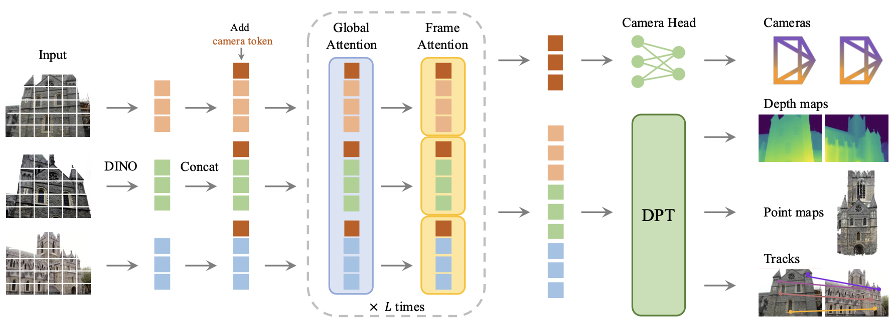
Network

Slide 6
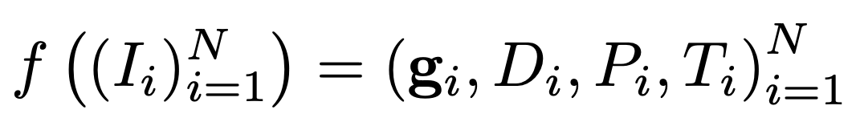
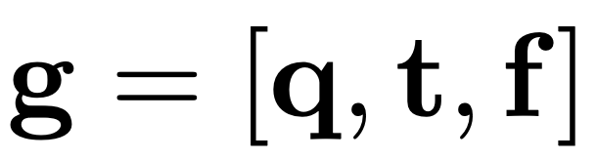
Details
Formulation
Order of predictions: The order of the images in the input sequence is arbitrary, except that the first image is chosen as the reference frame.
Over-complete predictions: Not all quantities predicted by VGGT are independent. However, tasking VGGT with explicitly predicting all afore- mentioned quantities during training brings substantial performance gains, even when these are related by closed-form relationships.
rotation quaternion q ∈ R⁴
translation vector t ∈ R³
field of view f ∈ R²

Slide 7
Details
Backbone: A large transformer
Input: Each input image I is initially patchified into a set of K tokens t^{I} ∈ R^{K×C} through DINO.
The combined set of image tokens from all frames, i.e., t^{I} = ∪^{N}_{i=1}{t^{I}_{i} }, is subsequently processed through the main network structure, alternating frame-wise and global self-attention layers. (24 layers, 1.2b params)
Alternating-Attention: making the transformer focus within each frame and globally in an alternate fashion. Frame-wise self-attention attends to the tokens tIk within each frame separately, and global self-attention attends to the tokens tI across all frames jointly.

Slide 8
Prediction heads
To predicts the these parameters, for each input image I_{i}, we augment the corresponding image tokens t^{I} with an additional camera token and four register tokens.
The camera token and register tokens of the first frame are set to a different set of learnable tokens to allow the model to distinguish the first frame from the rest.
Camera Predictions: The camera parameters (gˆ^{i})_{N}^{i=1} are predicted from the output camera tokens using four additional self-attention layers followed by a linear layer.
Dense Predictions: dense feature map converted to depth map D_{i} and point maps P_{i}.
Tracking: Using CoTracker2 architecture.

Slide 9
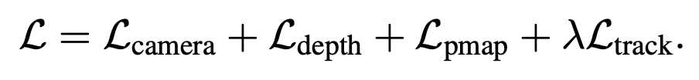
Training
Multi-task loss:
Augmentation: randomly apply color jittering, Gaussian blur, and grayscale augmentation to the frames.
The training runs on 64 A100 GPUs over nine days.
Data: Co3Dv2, BlendMVS, DL3DV, MegaDepth, Kubric, WildRGB, ScanNet, Hyper-Sim, Mapillary, Habitat, Replica, MVS-Synth, PointOdyssey, Virtual KITTI, Aria Synthetic Environments, Aria Digital Twin, and a synthetic dataset of artist-created assets similar to Objaverse.

Slide 10
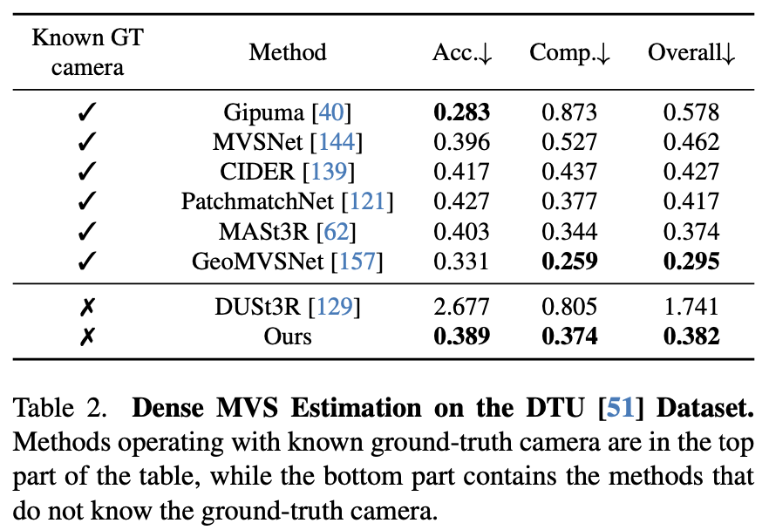
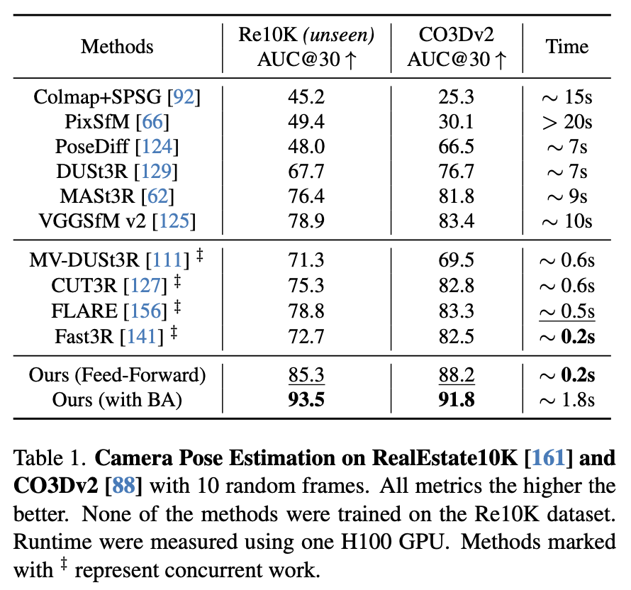
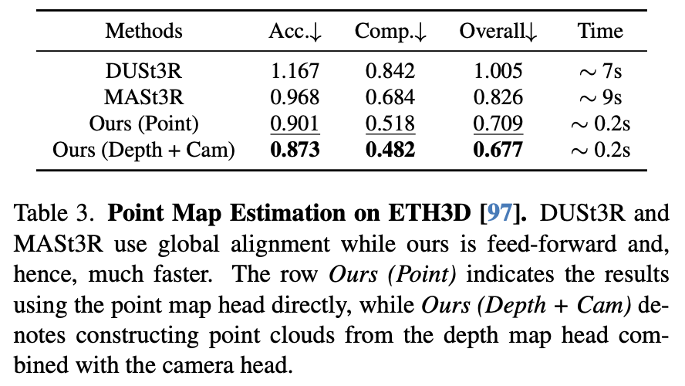
Experiments
Notes:
MVS: depth estimation
Area Under the Receiver Operating Characteristic Curve
ROC curve: plots the True Positive Rate (TPR, a.k.a. recall) against the False Positive Rate (FPR) at different classification thresholds. AUC: measures the area under this curve.
Value range:
1.0 → perfect classifier (always correct).
0.5 → random guess (no discriminative power).
< 0.5 → worse than random (model is systematically wrong).

Slide 11
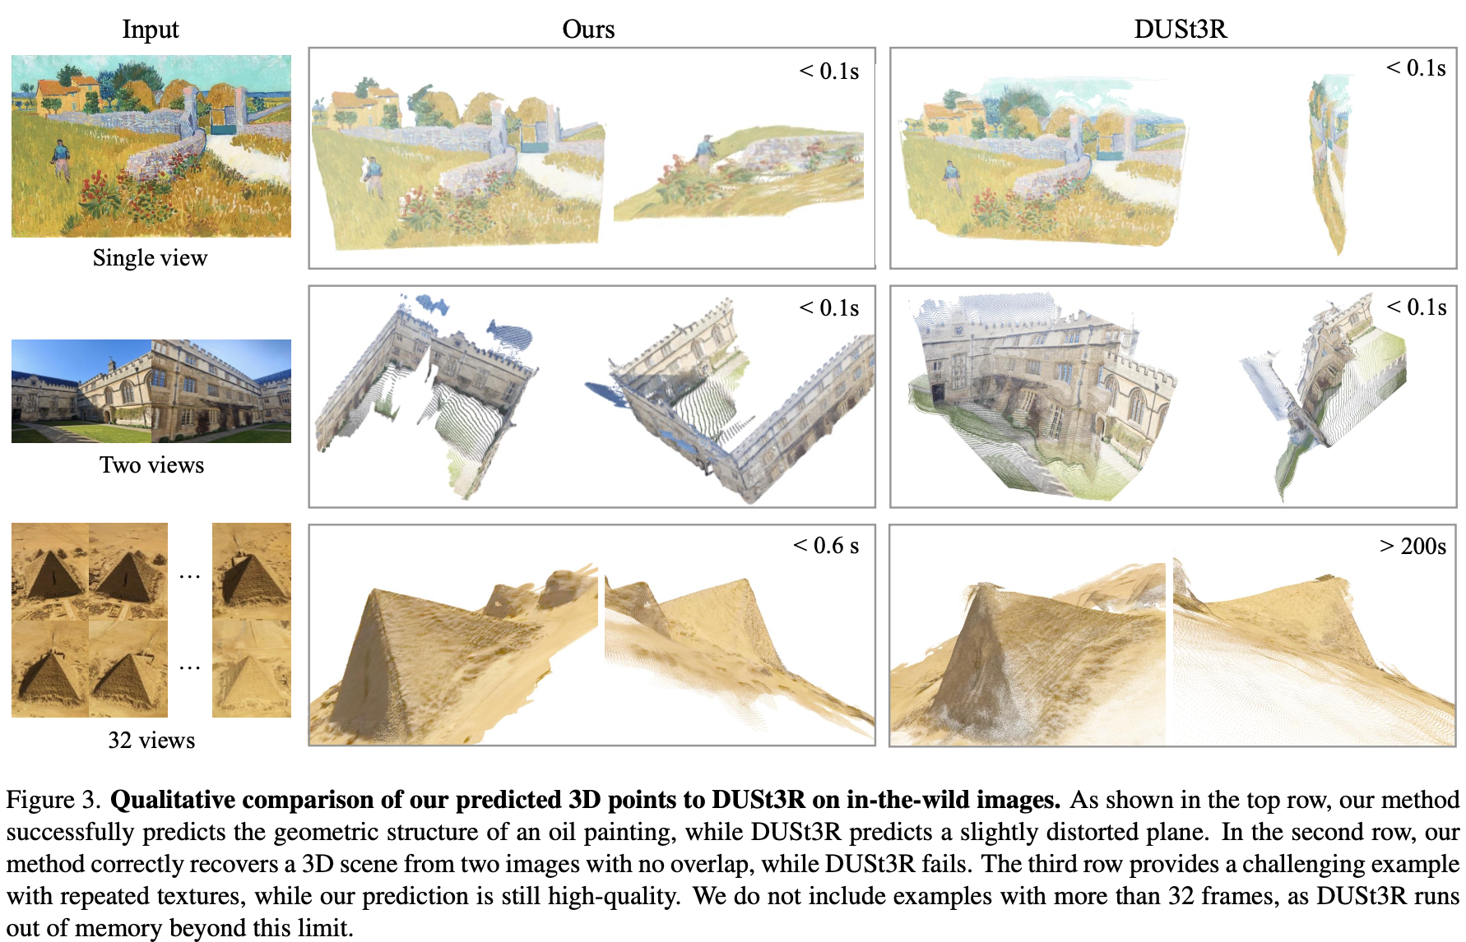
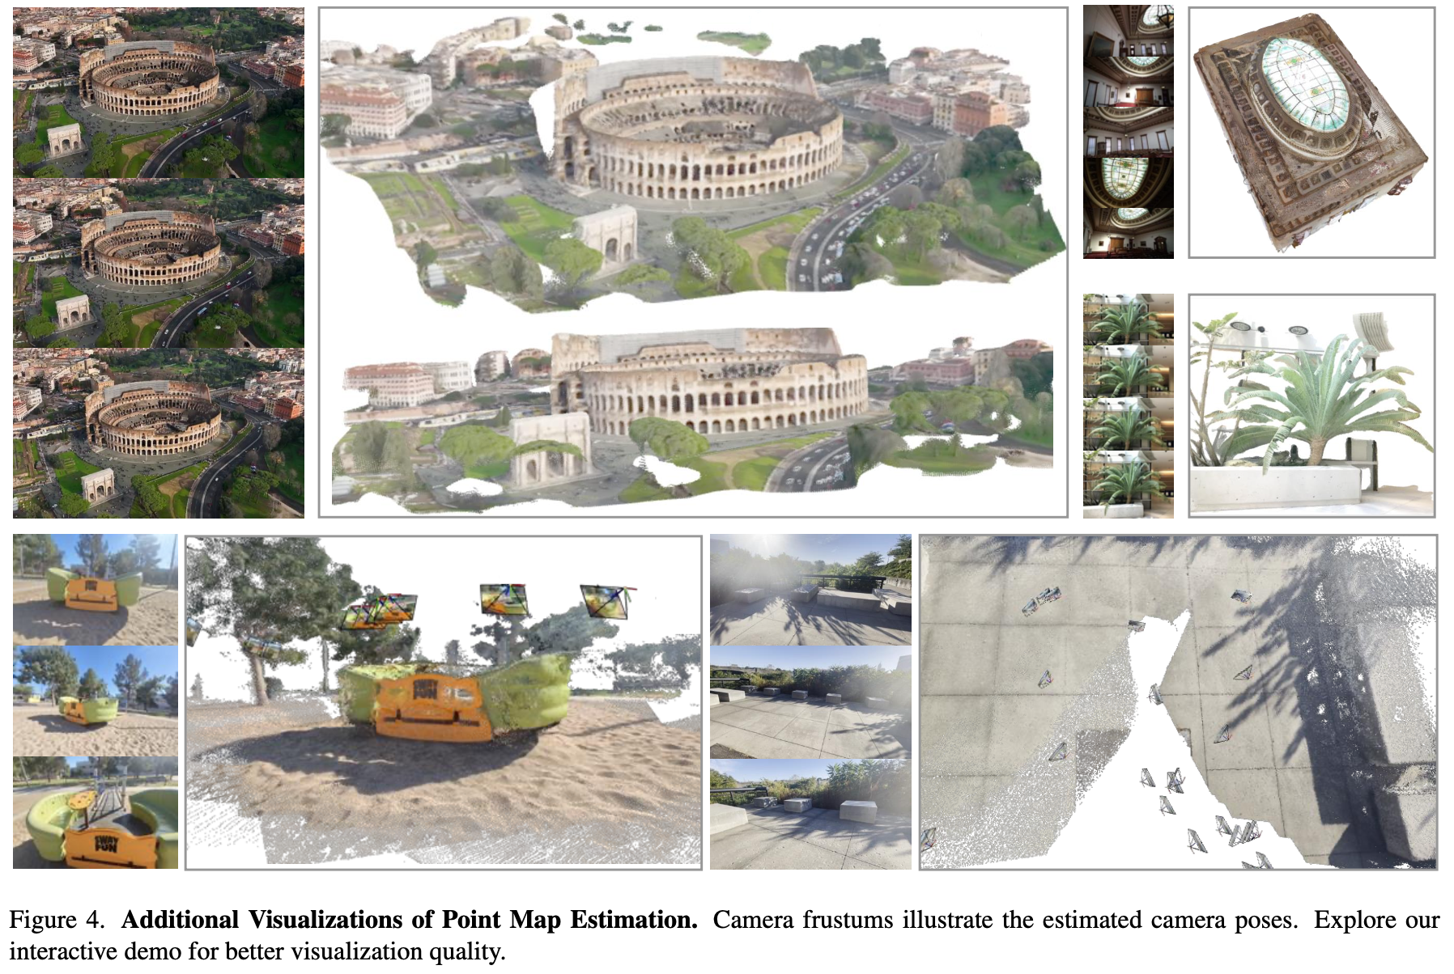
Experiments

Slide 12
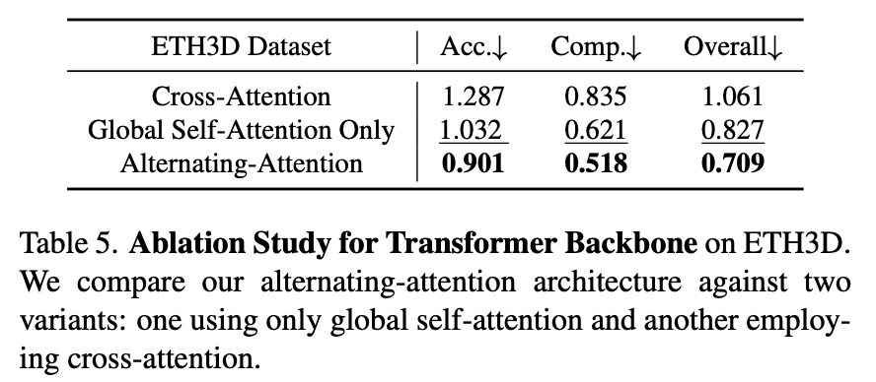
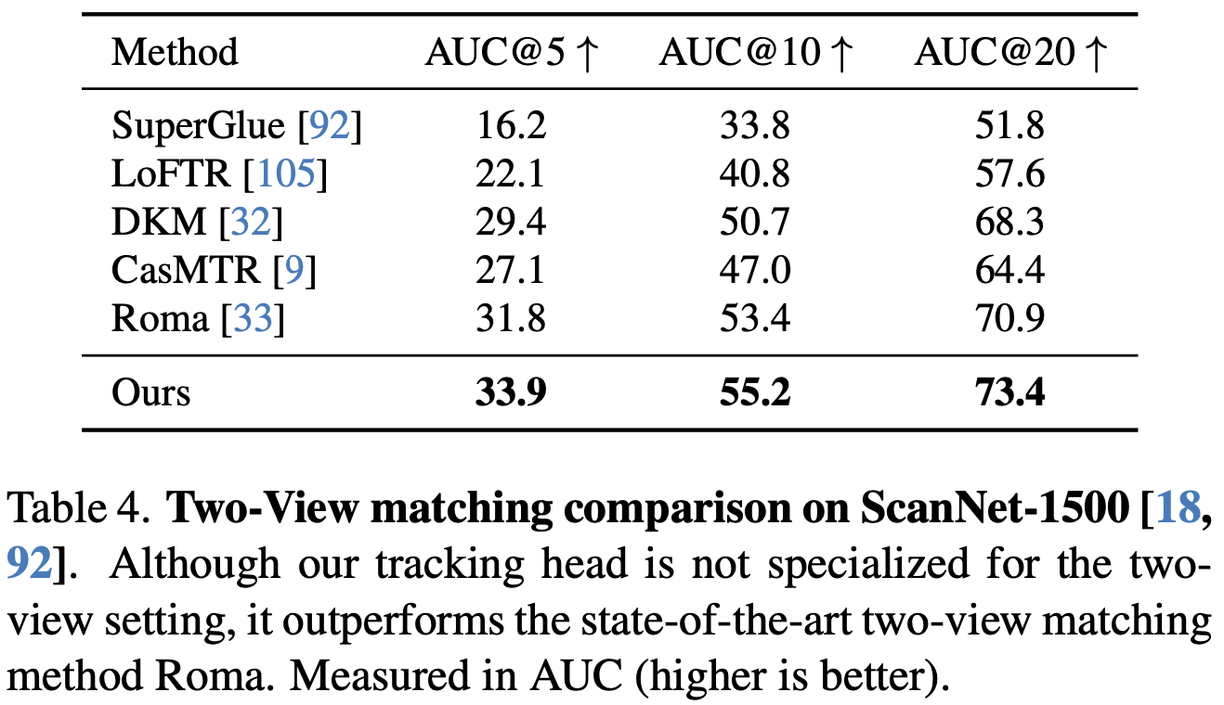
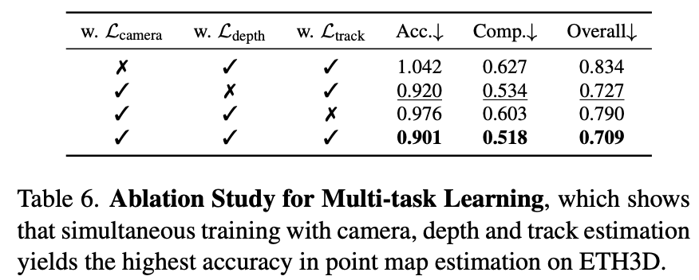
Experiments
Two-view image matching

Slide 13
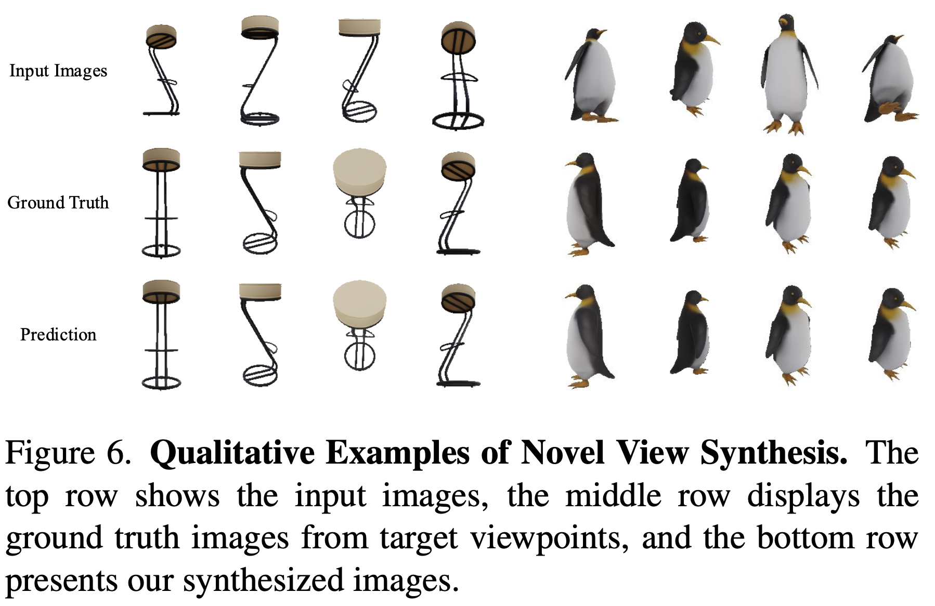
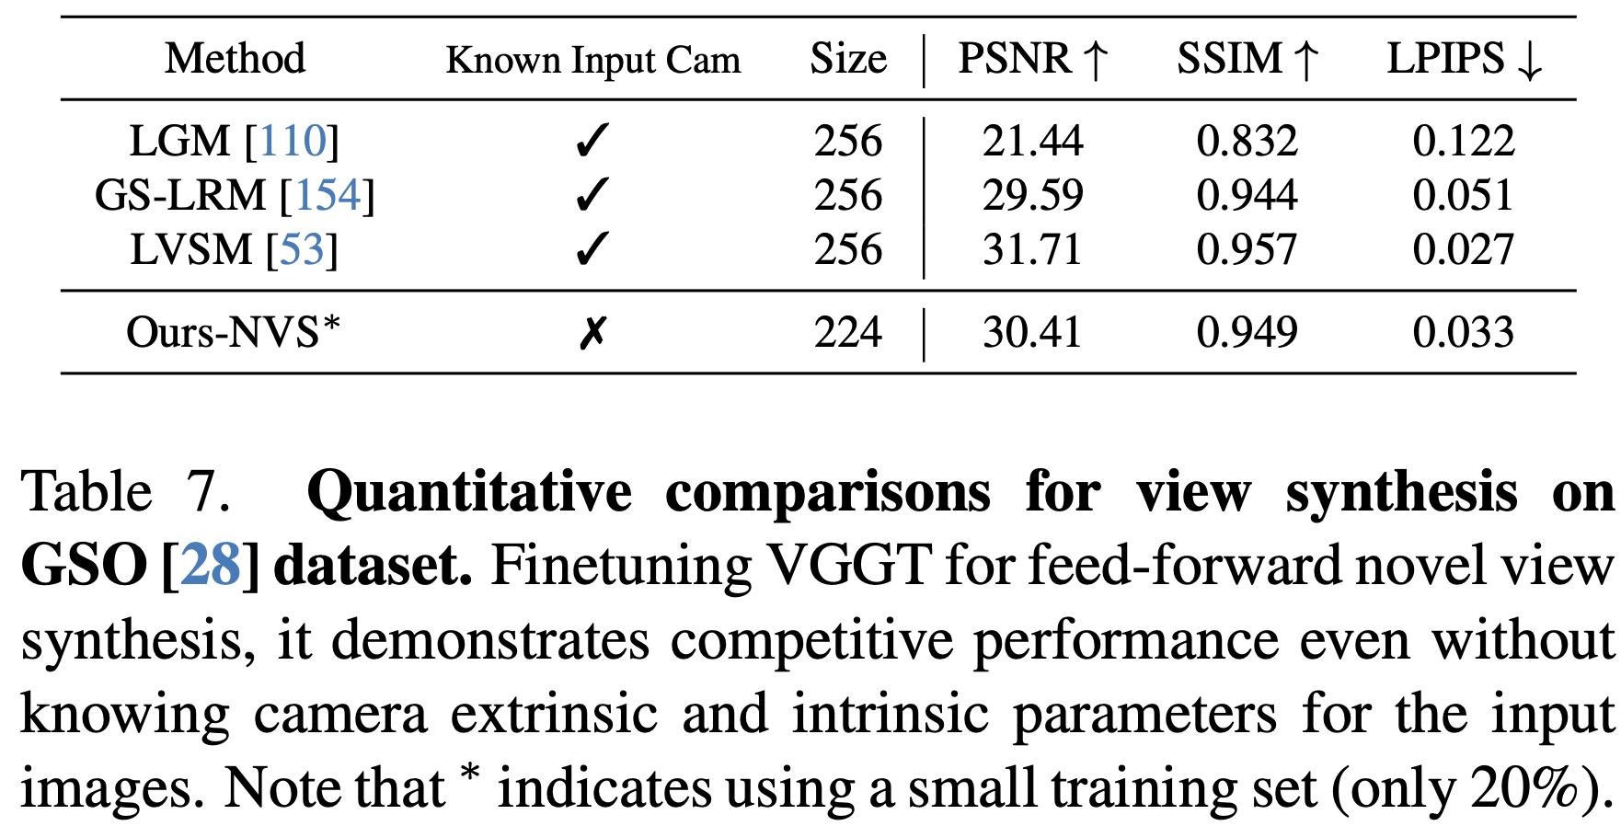
Finetuning for downstream tasks
Feed-forward novel view synthesis: Instead of relying on an explicit 3D representation, we follow LVSM [53] and modify VGGT to directly output the target image. However, we do not assume known camera parameters for the input frames.

Slide 14
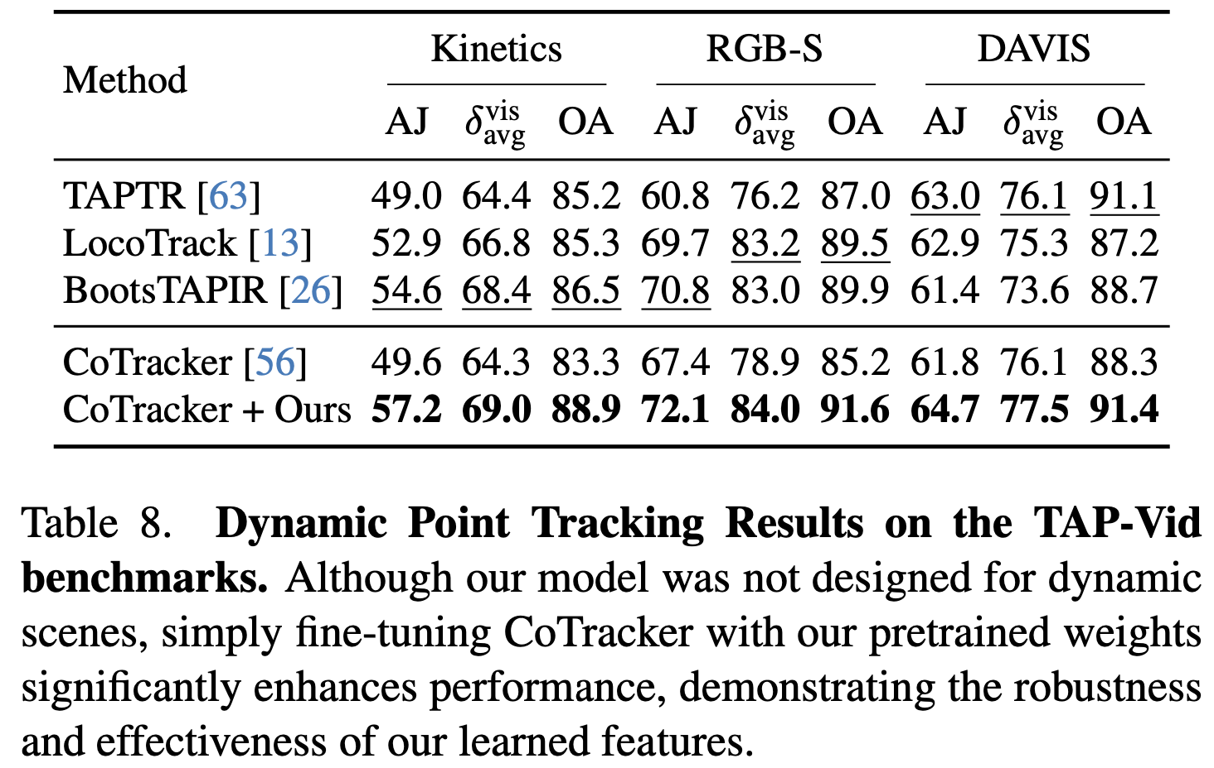
Finetuning for downstream tasks
Dynamic point tracking: We adapt the state-of-the-art CoTracker2 model by substituting its backbone with our pretrained feature backbone.

Slide 15
Discussions
Limitations: does not support fisheye or panoramic images; performance drop for extreme input rotations; fails in scenarios involving substantial non-rigid deformation.

